Slide 1
ERNIE VENTRALI NEL paziente affetto da obesità: TECNICA LAPAROSCOPICA O OPEN?
DR. Phd. Francesco DE Angelis
UOC Chirurgia generale universitaria –po terracina – sapienza università di roma-polo pontino
Fra.deangelis@uniroma1.it

Slide 2
no conflict of interest regarding this presentation

Slide 3

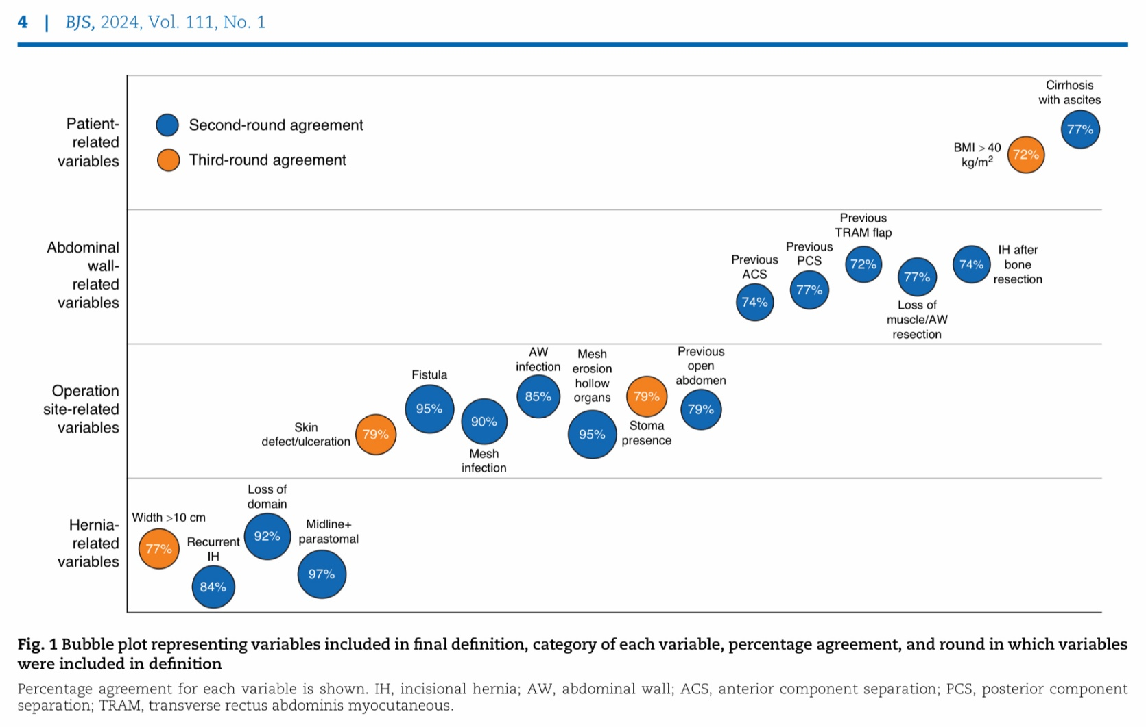

Slide 4
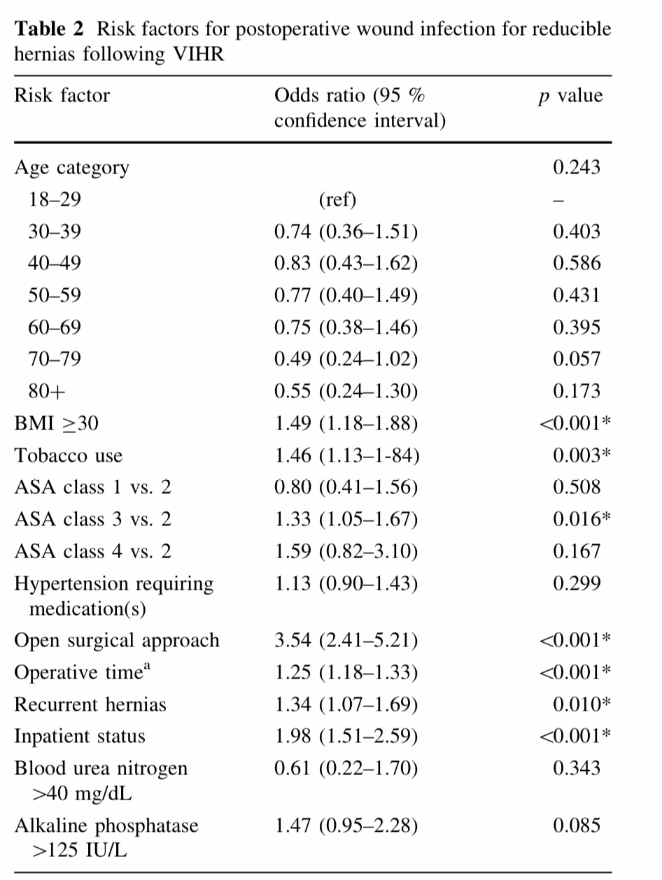
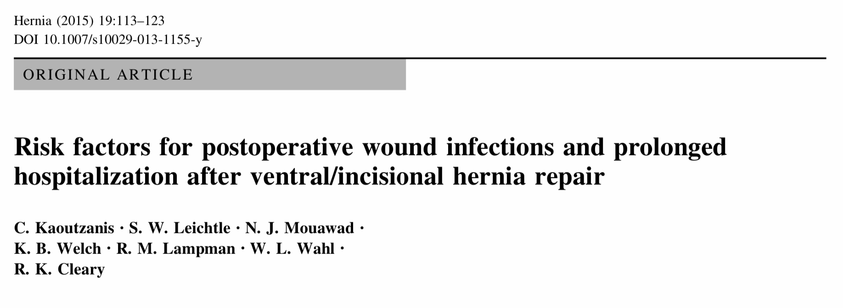
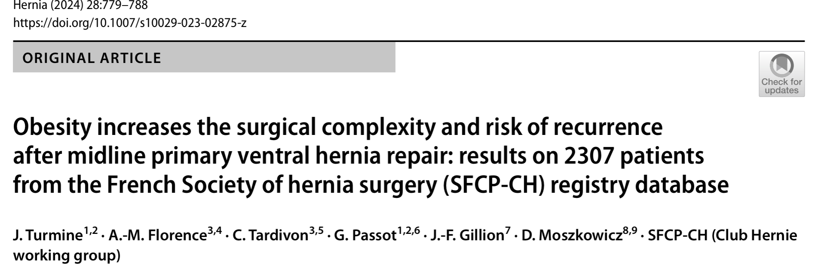

Slide 5

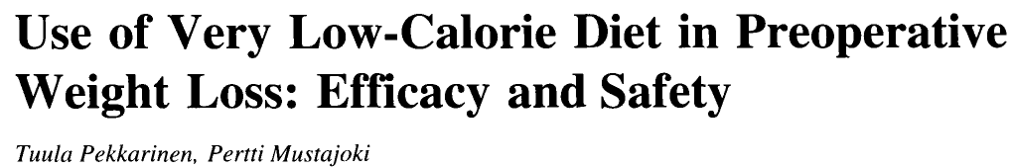

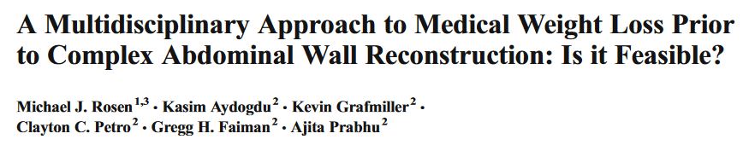
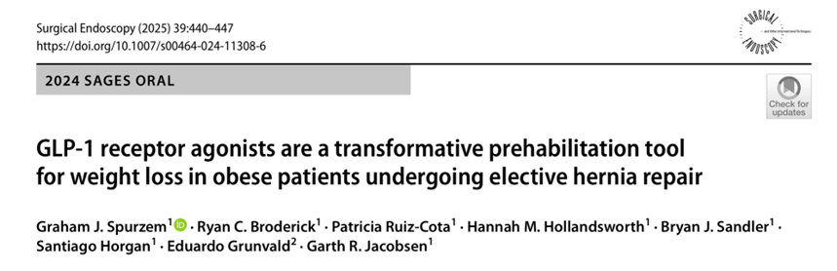
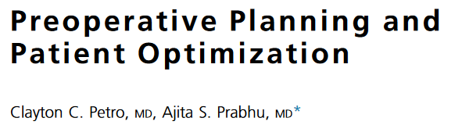
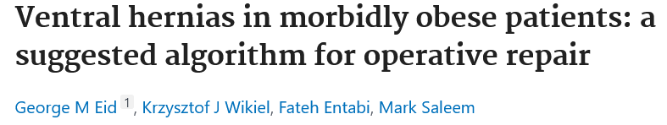
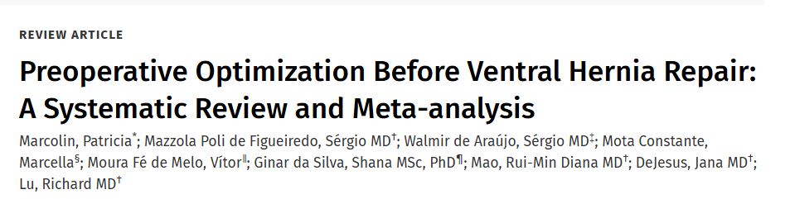
OBESITY
similar hernia recurrence, seroma, hematoma, and surgical site infection rates in patients who underwent preoperative optimization.

Slide 6

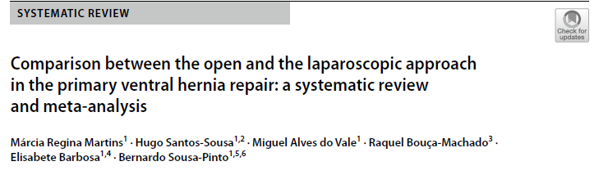
Laparoscopic repair
Open repair
results of available studies are controversial
high risk of bias (small sample sizes, and no well defined protocols)

Slide 7
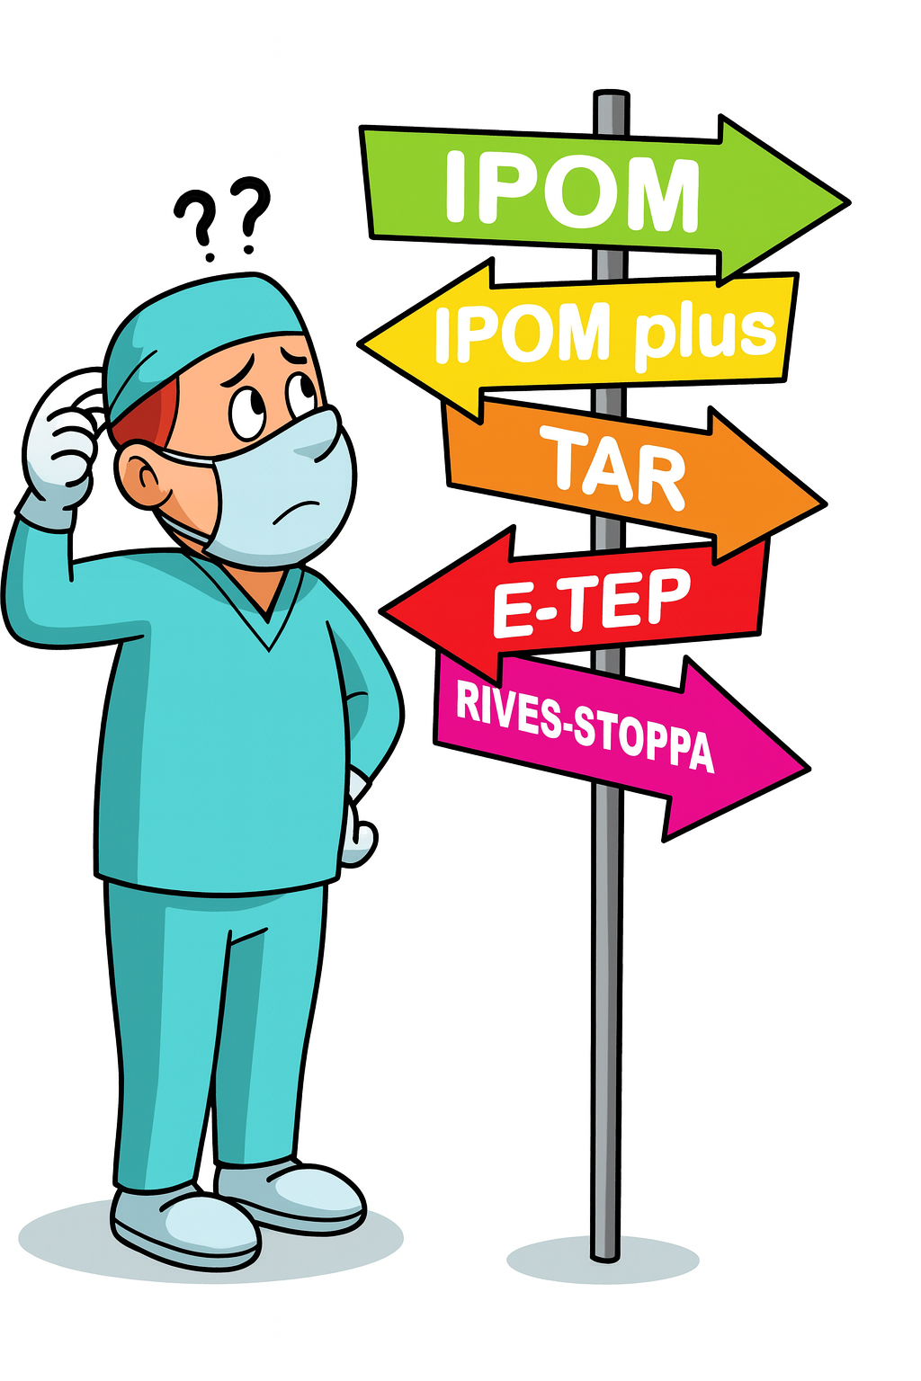
Which one?

Slide 8
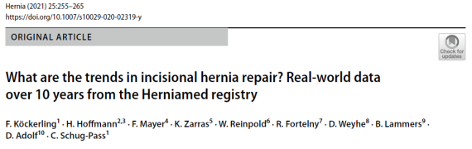
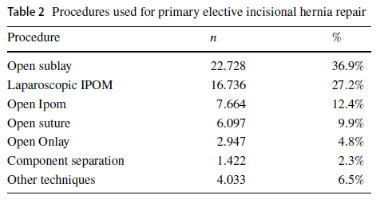
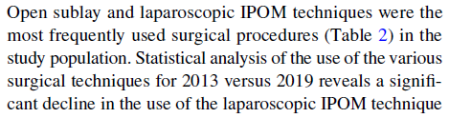

Slide 9
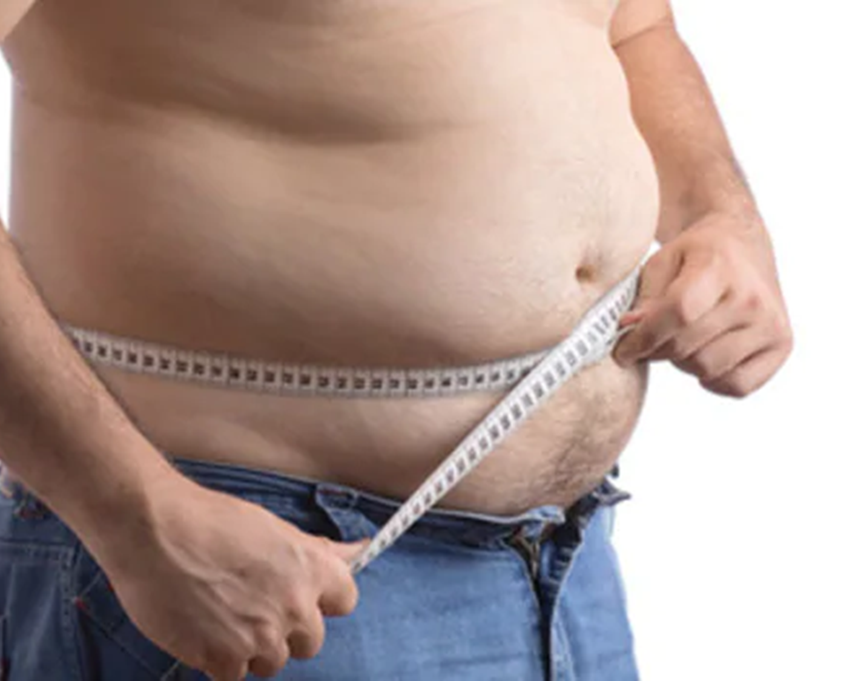
And in the obese?

Slide 10
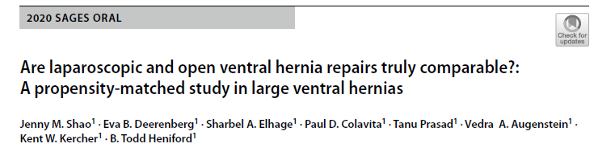
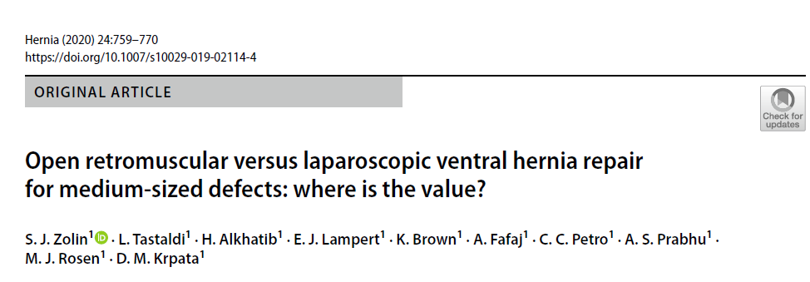
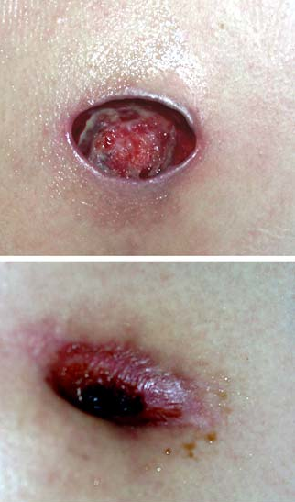
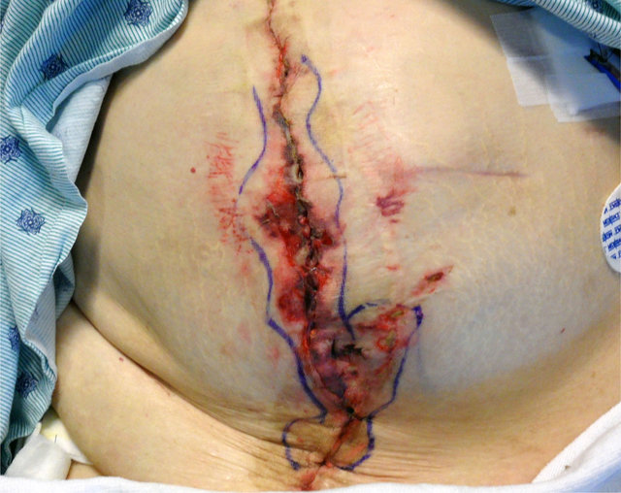
SSI/SSO
Open repair > SSI/SSO in obese patients

Slide 11
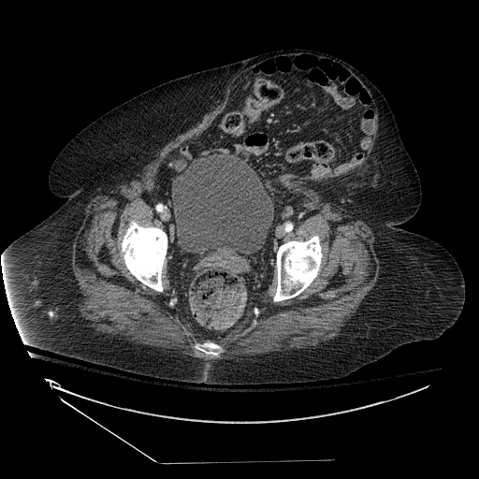
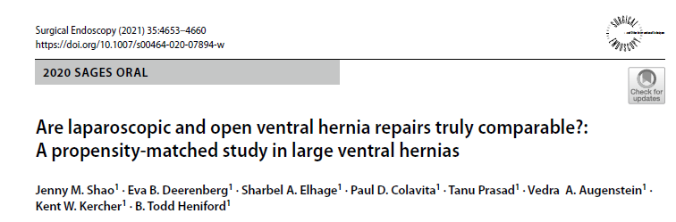
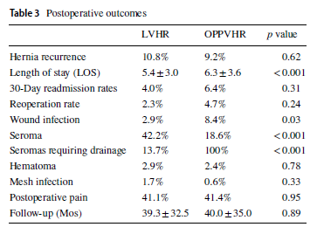
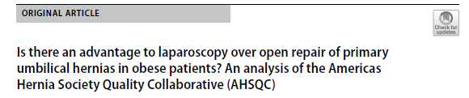
Recurrences
No difference beteween MIS and open surgery with retromuscolar technique
no benefit to laparoscopy over open umbilical hernia repair with mesh in terms of recurrence rate

Slide 12
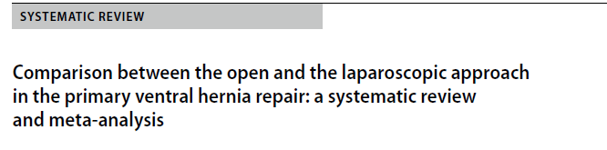
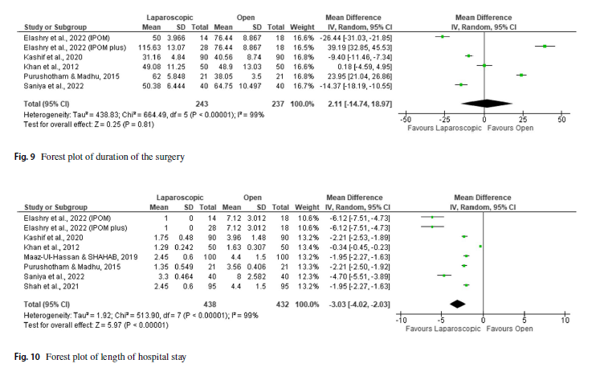
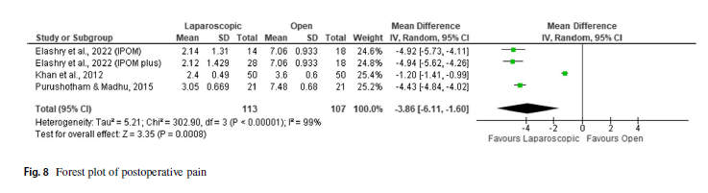
LOS , PAIN, OP. TIME
LOS shorter in MIS
Better post operative pain in MIS
Oparating time depending on surgery (e-TEP, TAR)

Slide 13

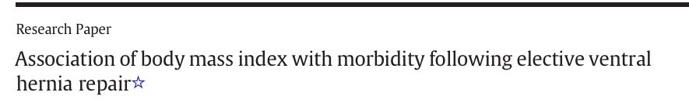
BMI> 32 significant increase in overall complications following open VHR

Slide 14
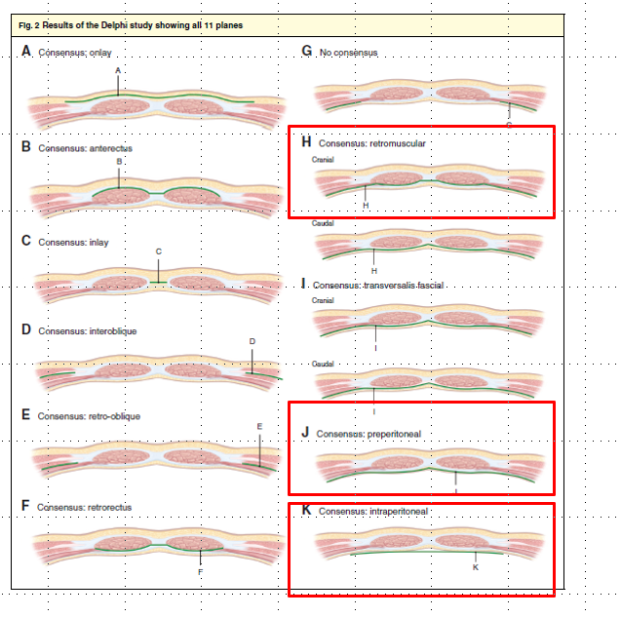
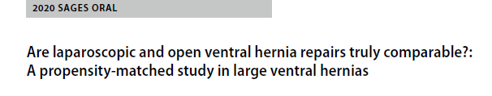
Mesh placement
Better result with retromuscolar – extraperitoneal placement

Slide 15

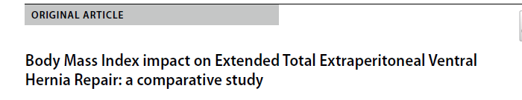
no statistically significant differences in terms of hernia relapses in the group with obesity compared with the group without obesity.
eTEP solves the limitations and problems related to placing an intraperitoneal mesh
Providing benefits from minimally invasive surgery

Slide 16

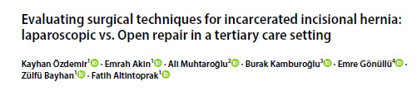
VHR in Emergency setting
Laparoscopic repair offers significant advantages over open repair for incarcerated incisional hernias:
shorter hospital stays,
lower postoperative pain
reduced perioperative bleeding.

Slide 17

Obesity significantly increases the risk of wound complications, surgical site infections (SSI), and recurrence after ventral hernia repair.
Laparoscopic repair reduces wound morbidity and hospital stay, with similar recurrence rates compared to open repair.
A BMI ≥ 32 marks a turning point — laparoscopy is safer and more beneficial in most obese patients.
The eTEP approach represents, from a future perspective, a better solution than IPOM for the minimally invasive treatment of ventral hernias.”
Individualize the approach — match the technique to the defect and the surgeon’s expertise.

Slide 18
Grazie

